Slide 1
10/24/23
Updated: 11/13/23
Board Physical Plan
STAC-v1

Slide 2
Fill in the following tables:
 | Name | Email | Cell Number
Chief: | Rahul Kumar | rahulkumar@berkeley.edu | 408-702-5845
Test Board name(s): | STAC Test Board v1
Board repo name in bwrcrepo.eecs.berkeley.edu “BWRC Boards” group | stac-pcb
Will there be more than 1 board design per panel? | no
Chip name: | STAC V1
Is the chip package a BGA? QFN? | QFN-64
Does the package have a corner mark? | Yes
Will a socket be used for the packaged die? Describe on a later page. | No
How many packaged die to be assembled onto the board? | 1
BGA ball or QFN pin pitch? | QFN (0.5mm)

Slide 3
How many boards to be fabricated? | 8
Do you want mounted cross-sections of your board? | yes
Surface finish required? ENIG, etc.? | ENIG
Preferred board house: | Sierra
How many boards do you want stuffed? | 7
Preferred assembly house: | Digicom
Do you want the assembly house to buy the parts? | No, purchase ourselves
Do you want the assembly house to buy the pastemask stencil? | Yes
Do you need a pastemask stencil for the BWRC custom jig? | No
Do you need any mechanical fixtures designed/machined? | No
Will you need to fit your test board on a probe station’s platen? | No

Slide 4
What dielectric laminate do you want for your board? | FR4 only
Cap construction (core construction or pre-preg)? | Pre-preg
Do you have edge-launch SMAs? What size fixed wrench? | Yes, 3/8” wrench needs 3/4” SMA pitch
If edge-launch SMAs, what board thickness is required? | 55mils +- 10%
Do you want the assembly house to use SMA heat sinks? | Yes
Do you have controlled impedance traces? SE? Diff pairs? | Only SE-50,k only on L1_Top
Do you require vias-in-pads? | No
How many power domains? Please list: | 2 supplies on chip (VDDD1V8, VDDIO3V3)
Maximum current draw + respective pin(s) | 300mA from any supply pin
For testing, do you require test pads for active scope probes? | yes
Do you require test pads for scope probe springy loops? | yes
Do you want test loops for attaching passive probes? | Test loops for ohming resistance
Do you need coax connectors to measure noise on power domains? | Yes
Do you want 4-40 mounting holes for standoffs at all four corners? The holes should be diameter 0.1285” at offset from board edge of 1/8” | Yes

Slide 5
PMOD Pitch (center-to-center) | 0.9” (use A, C, D)

Slide 6
Please list/describe any other requirements for the test board:
Voltage Domains:
6V input
--> pass through power protection
-->pass through LDO (1st stage LDO, 4.66V output)
--> goes to 2 separate LDOs (2nd stage LDOs) , 1 for VDDD1V8, 1 for VDDIO3V3
Also have 2 points where we can bypass supplies directly to the chip (nets named *EXT*).
Switching controlled by jumper across two adjacent header pins.
No separate analog/digital supply voltages.

Slide 7
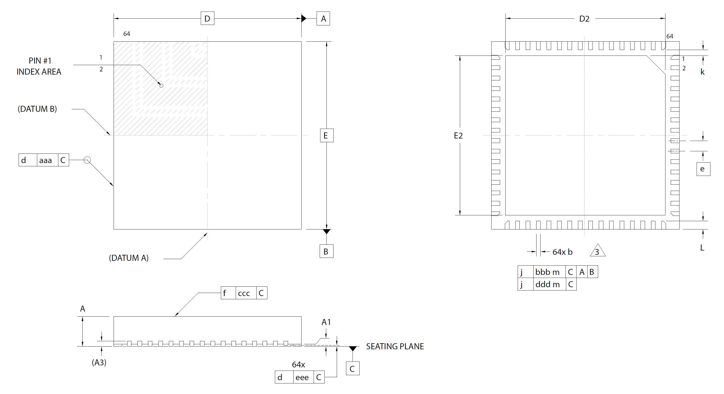
Drawing of package: QFN-64 w/exposed pad, 9mm x 9mm, 0.5mm pitch

Slide 8
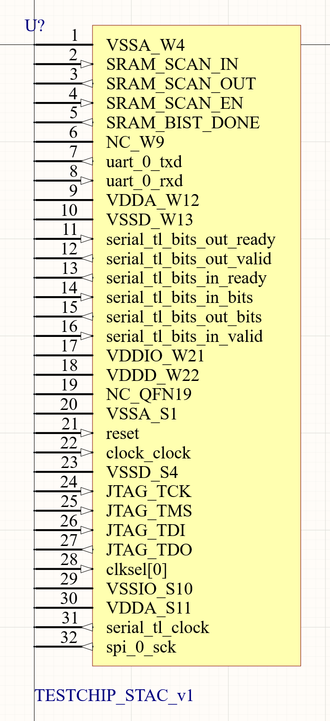
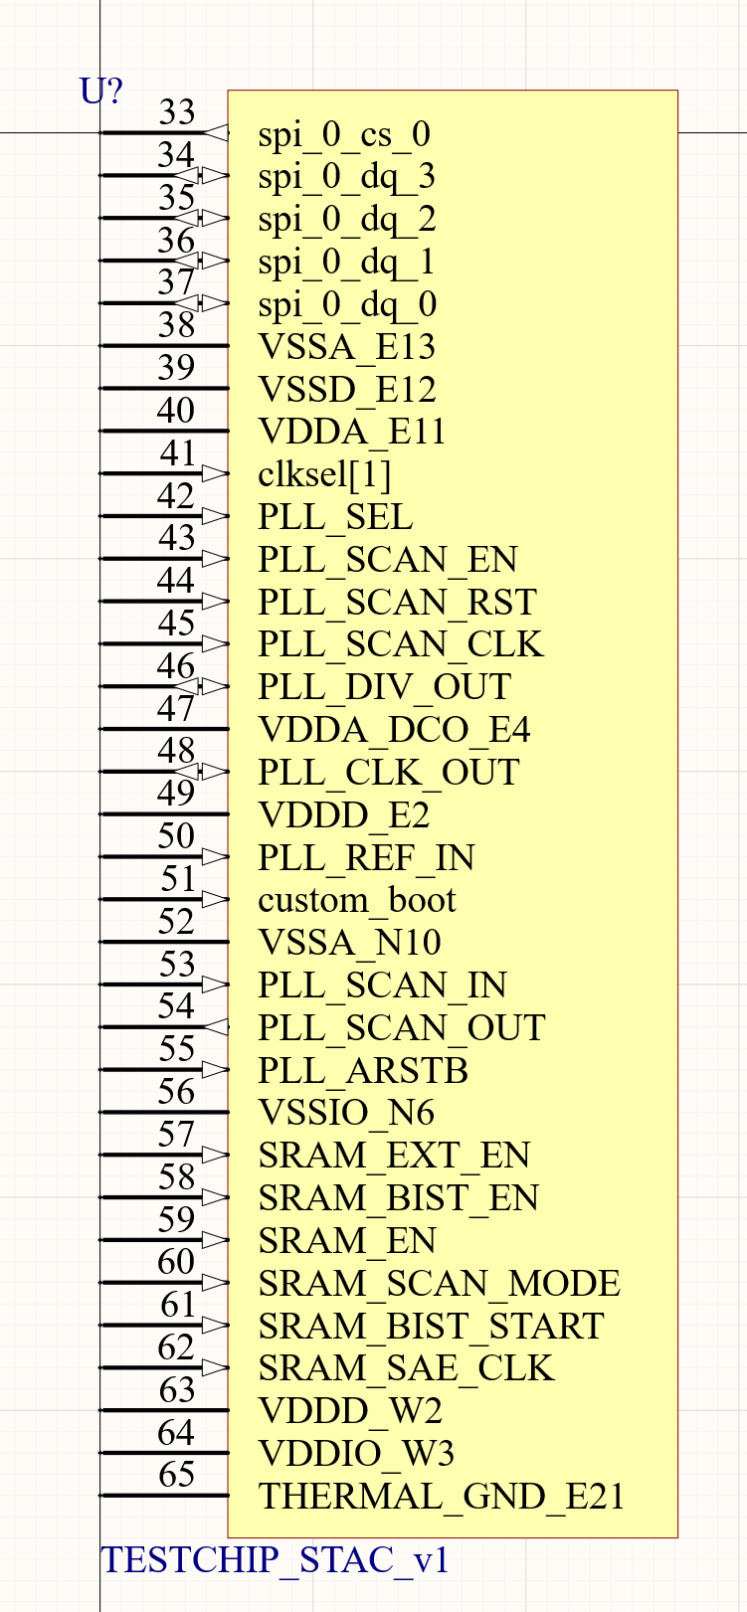
Please paste a screenshot of the Altium schematic symbol you created for you die and saved to BWRC.SchLib:

Slide 9
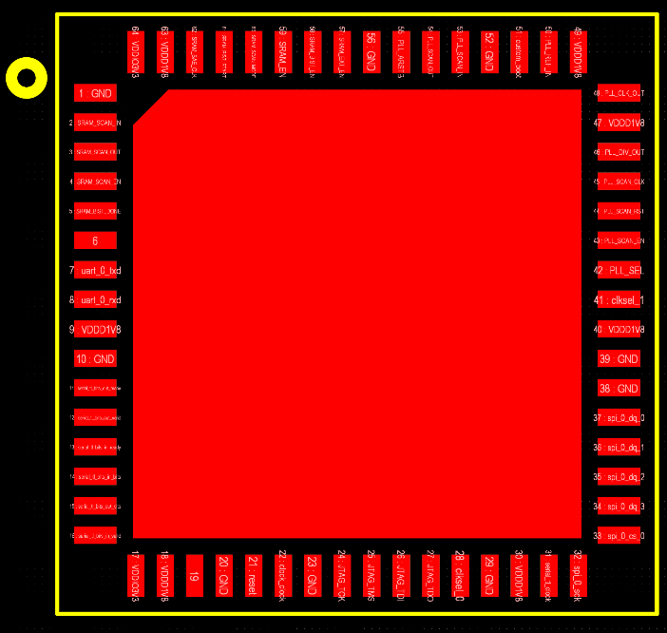
PLL_REF_IN
PLL_CLK_OUT
PLL_DIV_OUT
SRAM Test Area
PLL
Digital (Rocket core)
clock-_clock

Slide 10
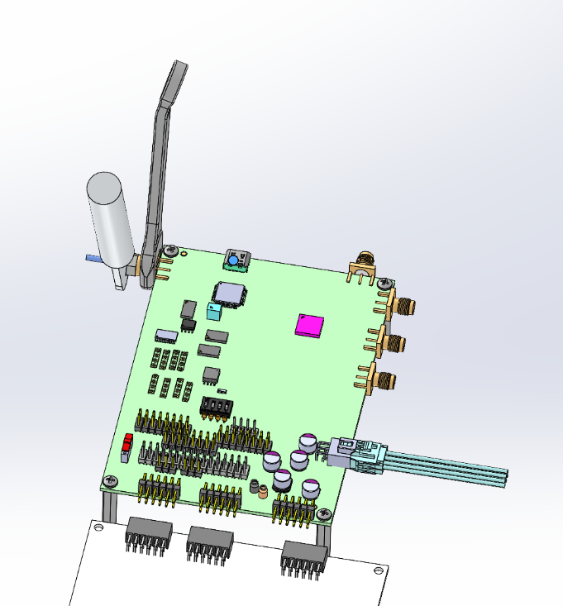
Physical constraints:
Main physical constraints: All controlled impedance traces can route on the top layer. The constraint is that other signals between the STAC die and the SMAs can’t cross on the top layer. Layout will start with these constraints (as shown at left):
Next most important physical constraints: Have 3 PMOD headers (6x2 pins each) with a center-to-center pitch of 0.9”. These must be on one edge of the board and will directly plug in to an Arty A7-100T FPGA. First PMOD header is 9/16” from the Arty top edge.
We’re using PMODs A, C, and D. So there will be one empty space amongst the 0.9” pitch connectors.

Slide 11
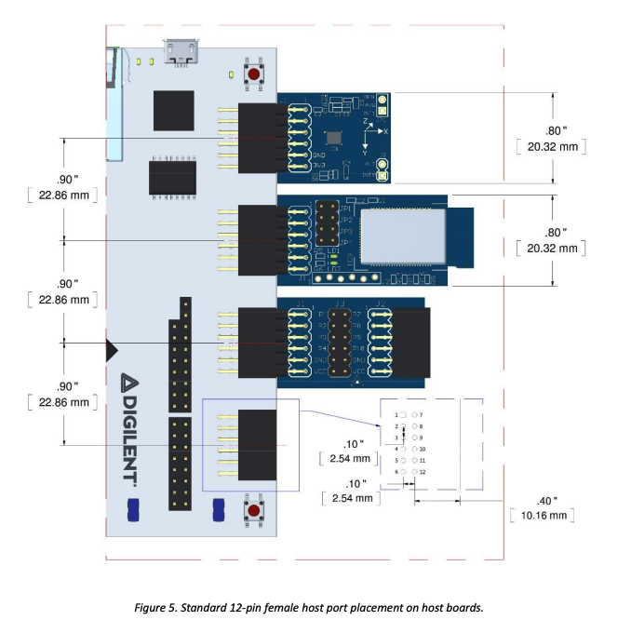
PMOD specifications
We will use PMODs A, C, and D.
In the picture to the right, the white Digilent board is the Arty. The STAC board will plug in (using male headers) to the 4 female PMOD connectors on the Arty.
Pins 5 and 11 are GND. Pins 6 and 12 are normally VCC, but we will no-connect them so that STAC and the Arty don’t share supplies.
PMOD specs: https://digilent.com/reference/_media/reference/pmod/pmod-interface-specification-1_3_1.pdf

Slide 12
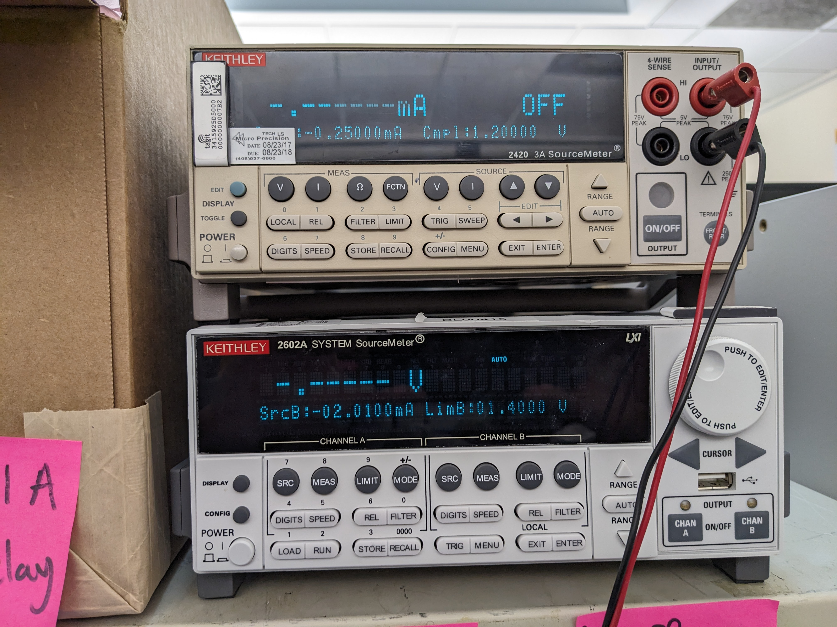
Source Meter
Where a precise voltage on VDDD (nominally 1.8V) is required, we will use a Keithley 2420 source meter.
Will connect banana plugs from source meter to 0.1” headers on the board. Board supports 4 wire connection, with the sense wires tied to the VDDD pin nearest to the SRAM test area.

Slide 13
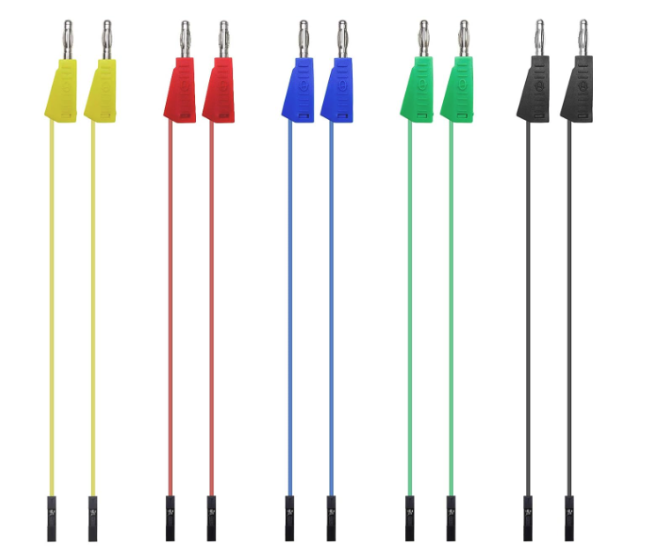
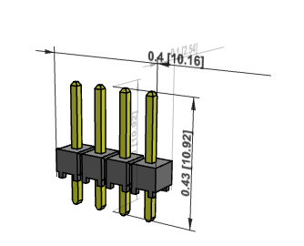
Source Meter Cables
An example cable for connecting the source meter to the board is shown to the right.
The headers on the board are Samtec TSW 0.1” male headers (see below).

Slide 14
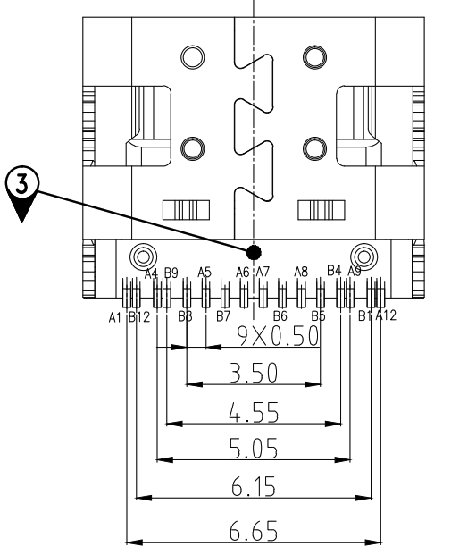
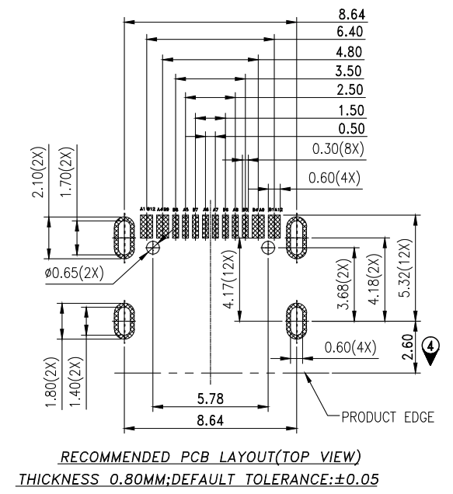
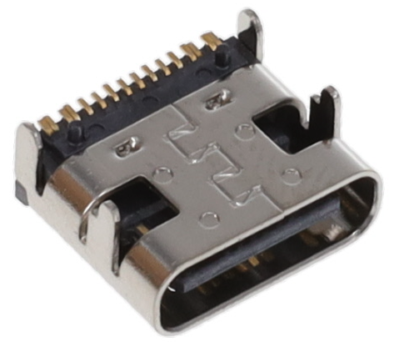
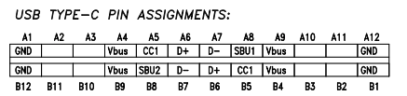
USB C Connection
An FTDI 2232HL IC adapts UART+JTAG from the Rocket to USB. A USB-C connector allows interfacing the FT2232HL to a laptop.
We are using a 12 pin Amphenol 12402012E212A connector.

Slide 15
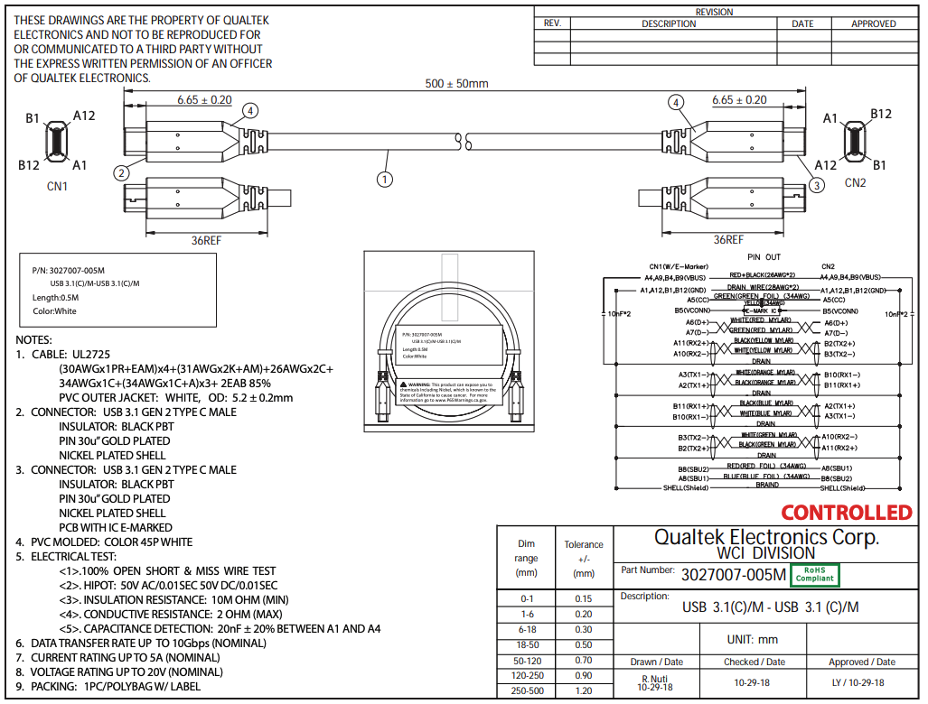
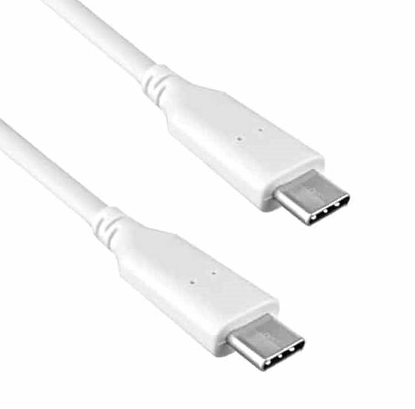
USB C Connection
The USB C connector should be placed so that it doesn’t interfere with the SMA connectors, and so that it is convenient to plug in both the STAC board and the Arty FPGA board to a laptop, occasionally at the same time. We’ll use a laptop with a USB C port (female).
We’ll use a cable such as Qualtek 3027007-005M.

Slide 16
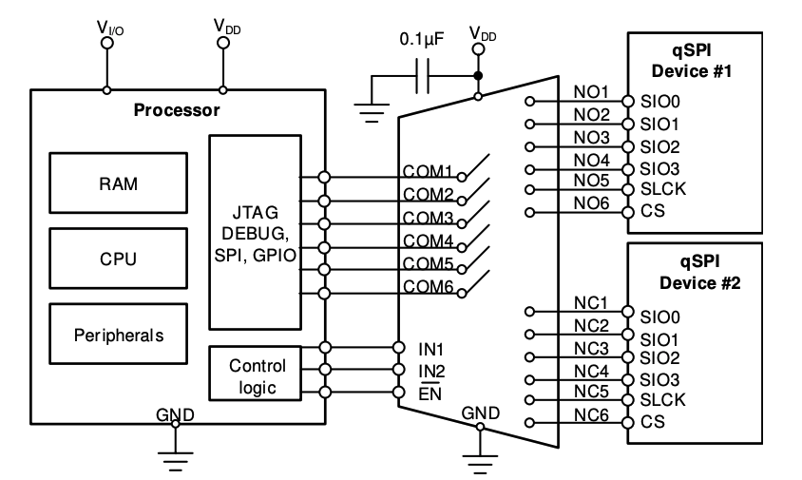
QSPI Muxing
We were originally thinking of having a separate breakout board (mounted on 2 4 pin headers, or via a vertical edge connector), but have switched to using an analog mux (TS3A27518EPWR) to activate 1 of 2 QSPI peripherals at the same time.
QSPI device 1 = flash
QSPI device 2 = PSRAM
Only one of the two will be operated at a time. It is fine if we need to reset the core or depower the board when switching devices; we aren’t trying to use both simultaneously.

Slide 17
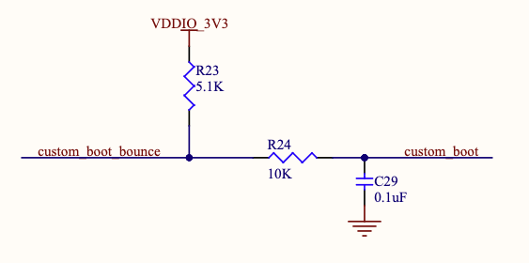
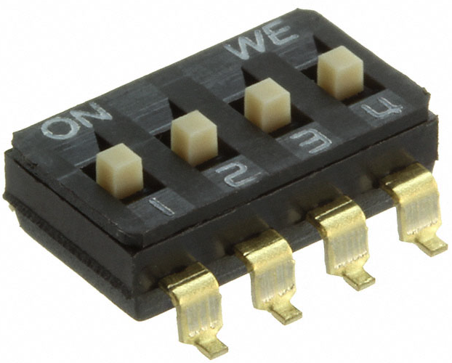
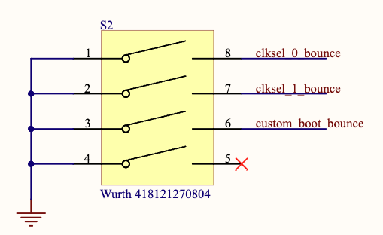
User Switches
We use a Wurth 418121270804 SPST switch to allow users to select values for clksel_0, clksel_1, custom_boot, and qspi_sel. All are pulled high by default. Closing a switch sets the corresponding signal low.
Switches are RC debounced.
(this pin is qspi_sel, not NC, in the latest board iteration)

Slide 18
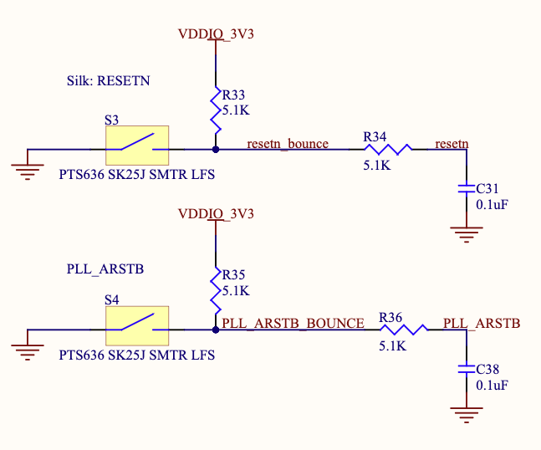
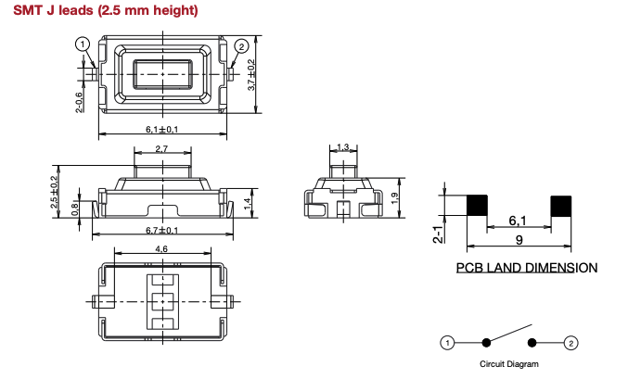
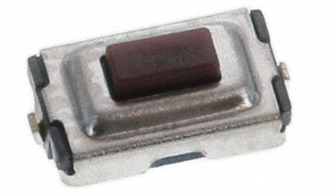
Reset Buttons
We have two active low reset buttons: one for the Rocket resetn, and the other for PLL_ARSTB.
Both are C&K PTS636 SK25J SMTR LFS.
We have RC debounce.

Slide 19
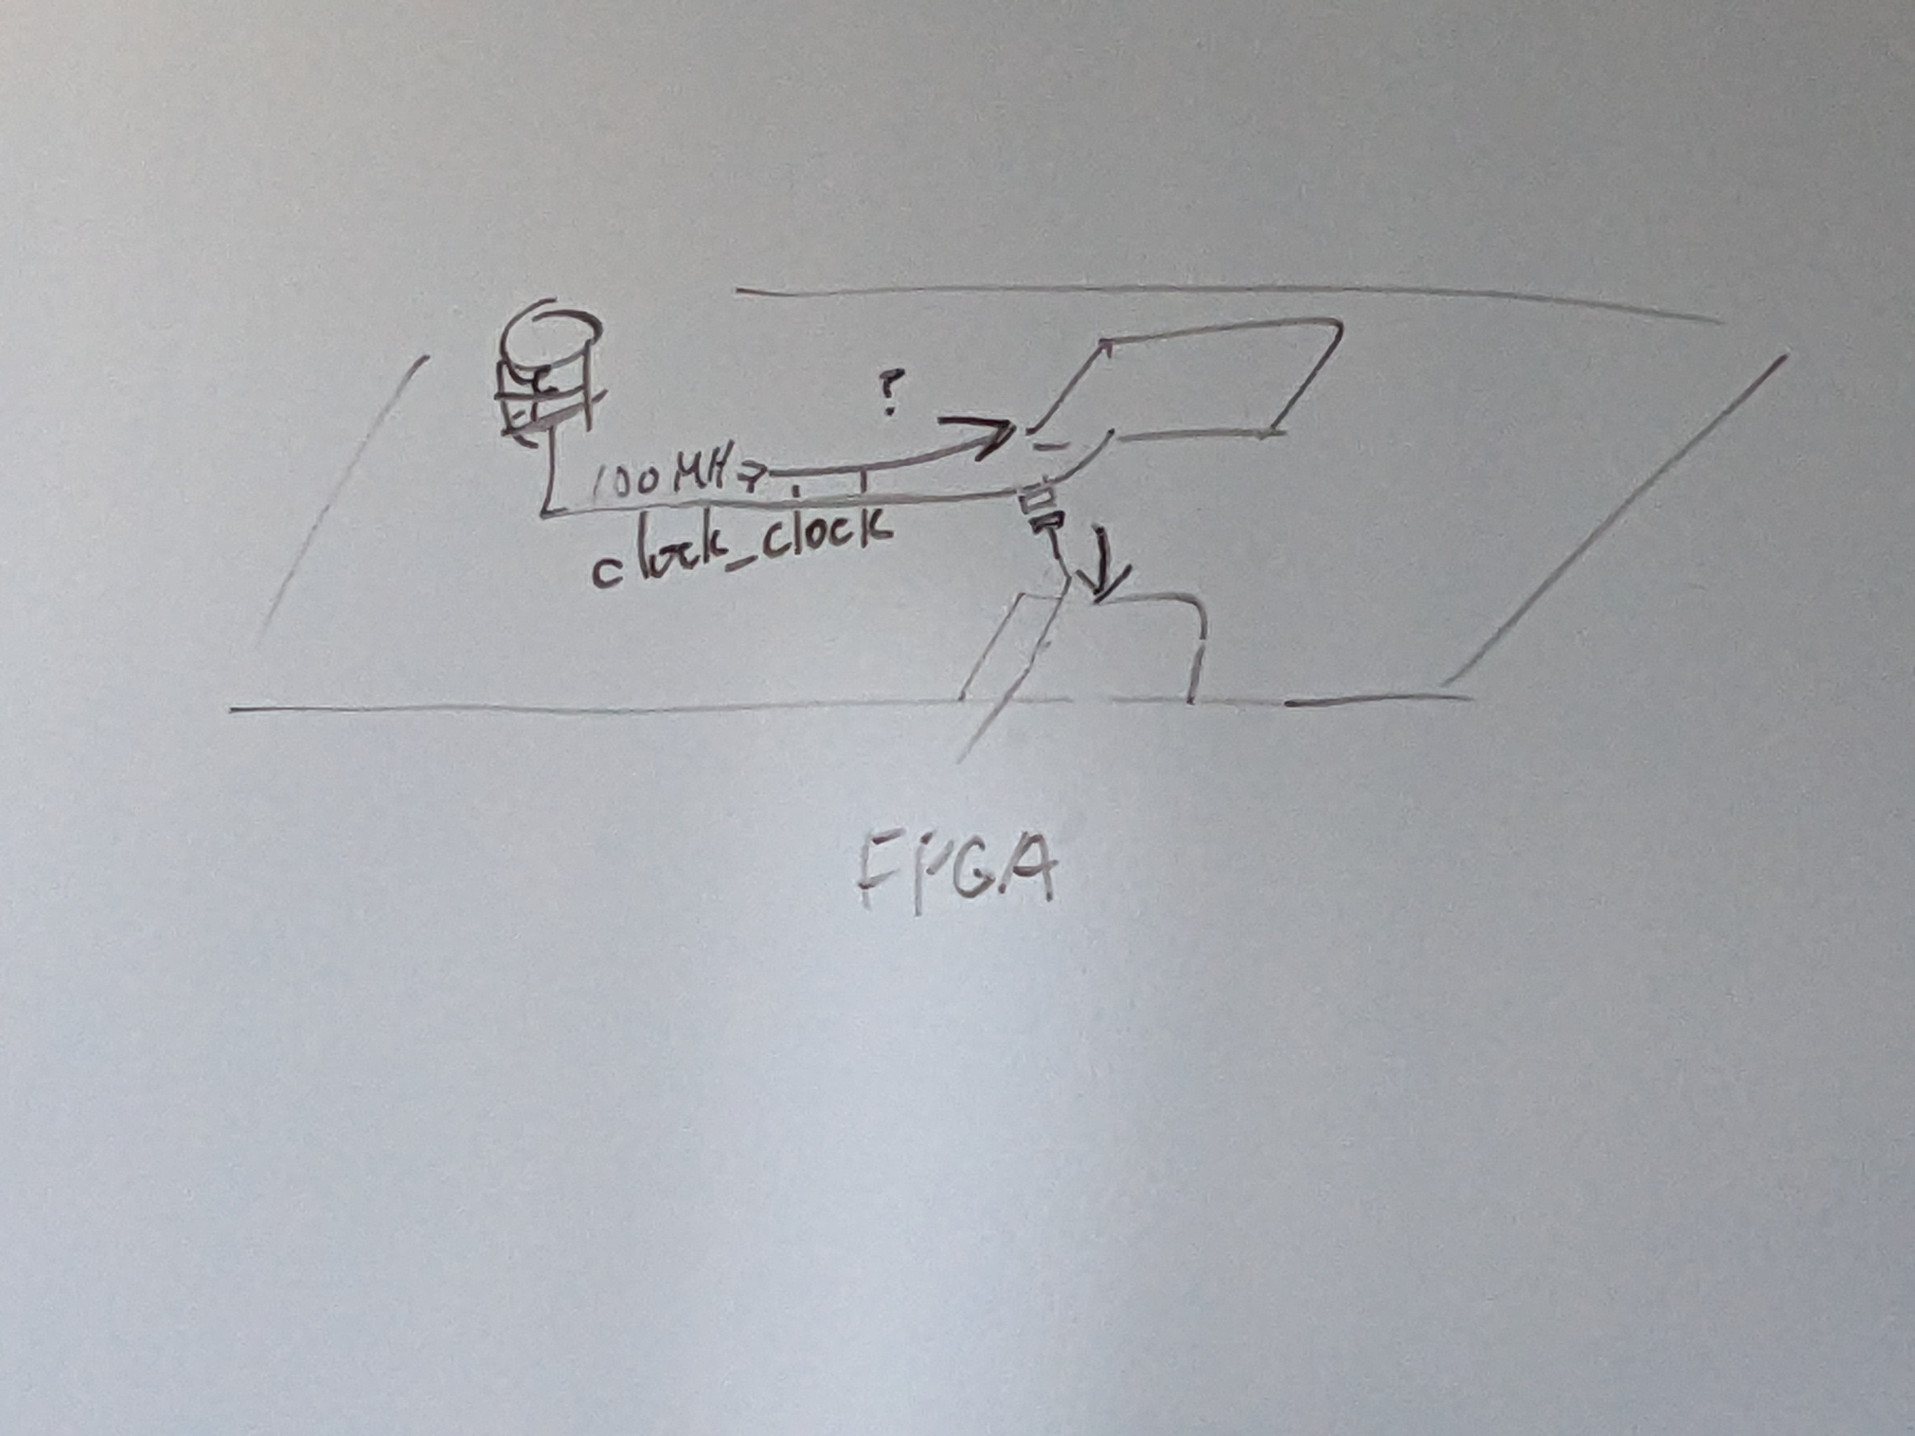
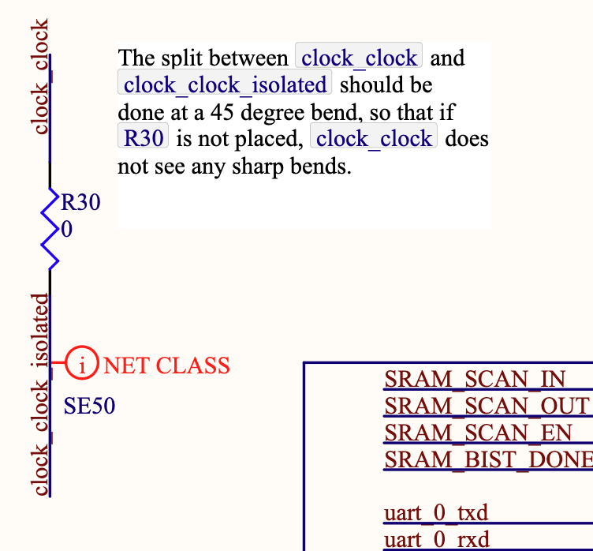
FPGA clock isolation
When supplying a high frequency clock via SMA, the source may use pre-emphasis (ie. Transmit a waveform that goes above 3.3V and/or below 0V). To be safe, we don’t want the FPGA to be exposed to these voltages, so when doing this, we will disconnect clock_clock from its PMOD connector by desoldering a 0 ohm resistor.
The connection should be done at 45 degree bend in clock_clock routing.

Slide 20
Notes for Assembly House

Slide 21
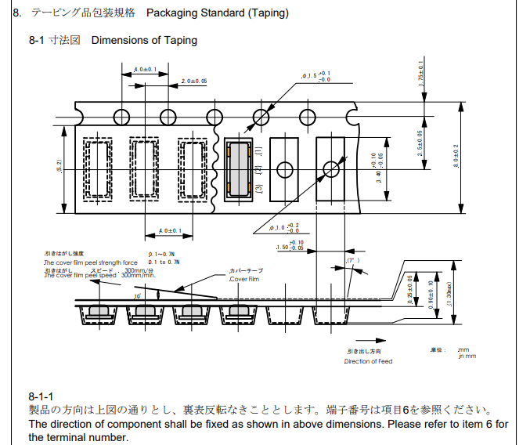
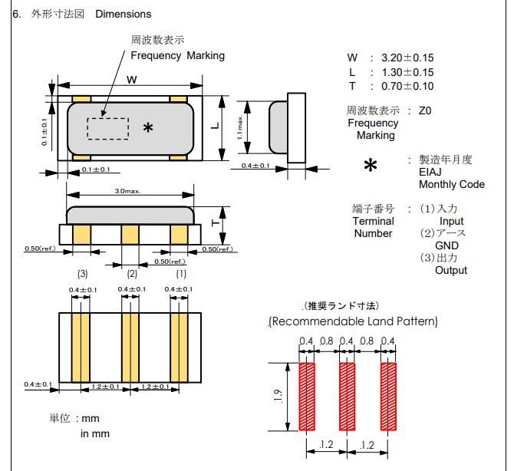
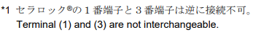
XTAL (Murata CSTNE12M0GH5L000R0)
The crystal looks symmetric, but according to the datasheet, pins 1 and 3 are not interchangeable. Need to make sure this gets assembled in the correct orientation.
The datasheet specifies the orientation of the crystal when it is packaged. Our PCB footprint indicates the pin numbers. Please make sure the crystal pins match the footprint pins when placed (ie. be careful not to rotate 180 degrees).
Links:
Digikey
Datasheet

Slide 22
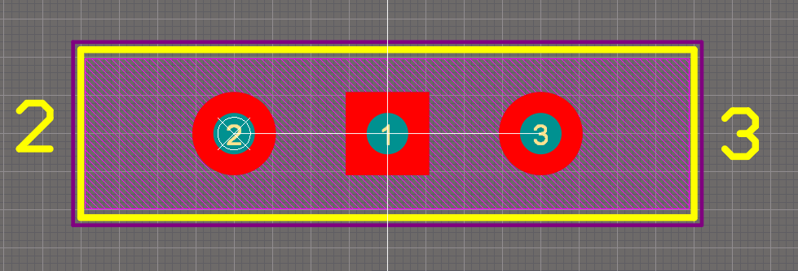
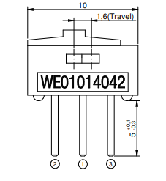
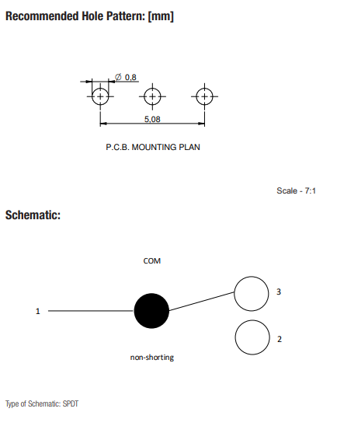
Power Switch (Wurth 450301014042)
This switch has an unconventional pin numbering: pin 1 is in the middle.
Our footprint indicates the locations of pins 2 and 3. Please make sure the switch is assembled matching the pin specification (ie. be careful not to rotate 180 degrees).
Links:
Digikey
Datasheet

